Slide 1
File Systems in Operating System

Slide 2
What is File in Operating System?
A file is defined as a collection of the interrelated information that is stored in the secondary memory or the non-volatile memory such as optical disk magnetic tapes and magnetic disks.
A file can also be defined as a sequence of records, bits, and bytes, and the meaning of the file is defined by the user or the creator of file. There is a logical location of each file where the files are located for storage and retrieval

Slide 3
Objectives of the File Management System
The objectives of the file management system are:
A File management system reduces the possibility of data lose or data destroyed.
A File management system provides the I/O’s facility for the multiple users in the multiuser system environment.
The File management system offers I/O support for the different types of storage devices.

Slide 4
Properties of a File system
The essential properties of the file system are:
We can store the file on a disk or on some other storage, and if a user logs off, the file would not disappear.
Files contain names and it is associated with access approval or permission, which allows controlled sharing.
The File can be arranged, or there may be a complex structure of the files which helps to reflect the relationship between them.

Slide 5
File Structure
It is must that a file structure should be in a predefined format so that the operating system can understand this correctly. File has a fully defined structure that is based on its types.
In the operating system, there are three kinds of the file system.
Text File: - Text File is defined as a sequence of organized characters in the lines.
Object File: - Object file means a series of bytes, and by using blocks, it is organized.
Source File: - Source File means a sequence of processes and functions.

Slide 6
Attribute of file
Name: - Each file contains a name through which we can recognize the file easily in the file system.
Identifier: - Along with the file name and its extension, which helps us to identify the file type. For Example: - .txt extension is used for a text file and .mp4 is used for video file.
Type: - The type attribute means there are various types of files, such as text file, executable file, an audio file, video file, etc.
Location: - In the File System, we use different locations to store the files, and every file contains its location as its attribute.
Size: - Size is an essential attribute of the file. The meaning of the size of the file is the number of bytes that takes a file in the memory.
Protection: - There are different types of protection which the admin of the computer may require for the different files. So, each file has its own set of permissions for the various groups of users.
Time and Date: - In the File System, each file contains a timestamp. A timestamp consists of the time and date of the file related to the last modification of the file.

Slide 7
Operations on the File
Create: - The create operation is the essential operation performed on the file. We can create various types of files by using different kinds of methods.
For example: - If we want to create a text file, we use a text editor, and if we want to create an image file, we use an image editor.
Write: - Writing a file is a different task from creating a file. In the write operation, for each file, the operating system maintains a write pointer, which is used to point the position in the file from where the data must be written.
Read: - We can open a file in three modes: Read, Write, and Append. With the help of an operating system, a read pointer is maintained, which is used to point the position from where the data is read.
Re-Position: - Re-position is also known as seeking. The re-position means based on the user requirement moving the file pointer forward and backward.
Delete: - In the delete operation, we delete the data stored in the file, and in addition to that, we also remove all the file attributes. Also deleting the file space, will free up the space, and we can use that free space for the allocation of other files.
Truncate: - Truncate is another operation that we perform on a file. In truncate operation, we only delete the file but do not delete the attributes of the file. In this, we do not delete the entire file, and we can replace the information which resides in the file.

Slide 8
File Access Methods
Sequential Access Method
Direct Access Method
Index Sequential Access Method

Slide 9
Sequential Access Method:
Sequential Access Method is one of the simplest file access methods. Most of the OS (operating system) uses a sequential access method to access the file. In this method, word by word, the operating system read the file, and we have a pointer that points the file’s base address. If we need to read the file’s first word, then there is a pointer that offers the word which we want to read and increment the value of the word by 1, and till the end of the file, this process will continue.
The Modern world system offers the facility of index access and direct access to file. But the sequential access method is one of the most used methods because more files like text files, audio files, and the video files require to be sequentially accessed.
Key Points:
Sequential Access Method is reasonable for tape.
In the sequential access method, if we use read command, then the pointer is moved ahead by 1.
If the write command is used, then the memory will be allocated, and at the end of the file, a pointer will be moved.

Slide 10
Direct Access Method:
Direct Access Method is also called the Relative access method. In the Database System, we mostly use the Direct Access Method. In most of the situations, there is a need for information in the filtered form from the database. And in that case, the speed of sequential access may be low and not efficient.
Let us assume that each storage block stores 4 records, and we already know that the block which we require is stored in the 10th block. In this situation, the sequential access method is not suitable. Since if we use this, then to access the record which is needed, this method will traverse all the blocks.
So, in this situation, the Direct access method gives a more satisfying result, else the OS (operating system) needs to perform a few complex jobs like defining the block number, which is required. It is mostly implemented in the application of the database.

Slide 11
Index Access Method
Index Access Method is another essential method of file, accessing. In this method, for a file an index is created, and the index is just like an index which is at the back of the book. The index includes the pointer to the different blocks. If we want to find a record in the file, then first, we search in the index, and after that, with the help of the pointer, we can directly access the file.
In the Index Access method, we can search fast in the large database, and also easy. But in this, the method need some additional space to store the value of the index in the memory.
Key Points:
On top of the sequential access method, the index access method is built.
The Index access method can control the pointer with the help of the index.

Slide 12
File Allocation Methods
There are different kinds of methods that are used to allocate disk space. We must select the best method for the file allocation because it will directly affect the system performance and system efficiency. With the help of the allocation method, we can utilize the disk, and also files can be accessed.
There are various types of file allocations method:
Contiguous allocation
Extents
Linked allocation
Clustering
FAT
Indexed allocation
Linked Indexed allocation
Multilevel Indexed allocation
Inode

Slide 13
There are different types of file allocation methods, but we mainly use three types of file allocation methods:
Contiguous allocation
Linked list allocation
Indexed allocation
These methods provide quick access to the file blocks and also the utilization of disk space in an efficient manner.

Slide 14
Continuous allocation
Contiguous allocation is one of the most used methods for allocation. Contiguous allocation means we allocate the block in such a manner, so that in the hard disk, all the blocks get the contiguous physical block.
We can see in the below figure that in the directory, we have three files. In the table, we have mentioned the starting block and the length of all the files. We can see in the table that for each file, we allocate a contiguous block.

Slide 15
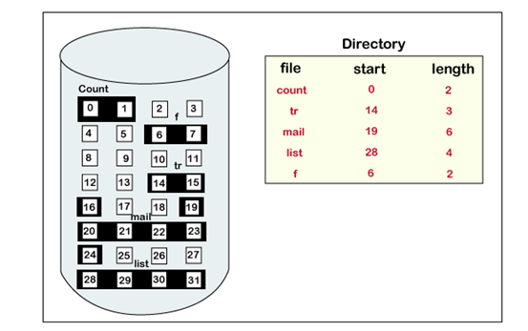
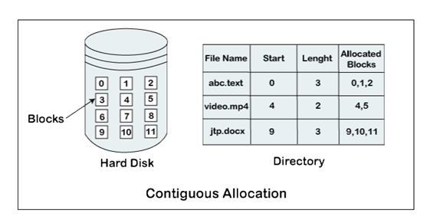
Example of contiguous allocation
We can see in the given diagram, that there is a file. The name of the file is ‘mail.’ The file starts from the 19th block and the length of the file is 6. So, the file occupies 6 blocks in a contiguous manner. Thus, it will hold blocks 19, 20, 21, 22, 23, 24.

Slide 16
Advantages of Contiguous Allocation
The advantages of contiguous allocation are:
The contiguous allocation method gives excellent read performance.
Contiguous allocation is easy to implement.
The contiguous allocation method supports both types of file access methods that are sequential access and direct access.
The Contiguous allocation method is fast because, in this method number of seeks is less due to the contiguous allocation of file blocks.
Disadvantages of Contiguous allocation
The disadvantages of contiguous allocation method are:
In the contiguous allocation method, sometimes disk can be fragmented.
In this method, it is difficult to increase the size of the file due to the availability of the contiguous memory block.

Slide 17
Linked List Allocation
The linked list allocation method overcomes the drawbacks of the contiguous allocation method. In this file allocation method, each file is treated as a linked list of disks blocks. In the linked list allocation method, it is not required that disk blocks assigned to a specific file are in the contiguous order on the disk. The directory entry comprises of a pointer for starting file block and also for the ending file block. Each disk block that is allocated or assigned to a file consists of a pointer, and that pointer point the next block of the disk, which is allocated to the same file.

Slide 18
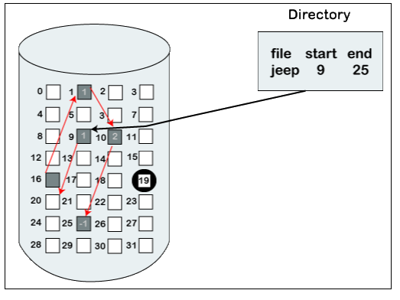
Example of linked list allocation
We can see in the below figure that we have a file named ‘jeep.’ The value of the start is 9. So, we have to start the allocation from the 9th block, and blocks are allocated in a random manner. The value of the end is 25. It means the allocation is finished on the 25th block. We can see in the below figure that the block (25) comprised of -1, which means a null pointer, and it will not point to another block.

Slide 19
Advantages of Linked list allocation
There are various advantages of linked list allocation:
In liked list allocation, there is no external fragmentation. Due to this, we can utilize the memory better.
In linked list allocation, a directory entry only comprises of the starting block address.
The linked allocation method is flexible because we can quickly increase the size of the file because, in this to allocate a file, we do not require a chunk of memory in a contiguous form.
Disadvantages of Linked list Allocation
There are various disadvantages of linked list allocation:
Linked list allocation does not support direct access or random access.
In linked list allocation, we need to traverse each block.
If the pointer in the linked list break in linked list allocation, then the file gets corrupted.
In the disk block for the pointer, it needs some extra space.

Slide 20
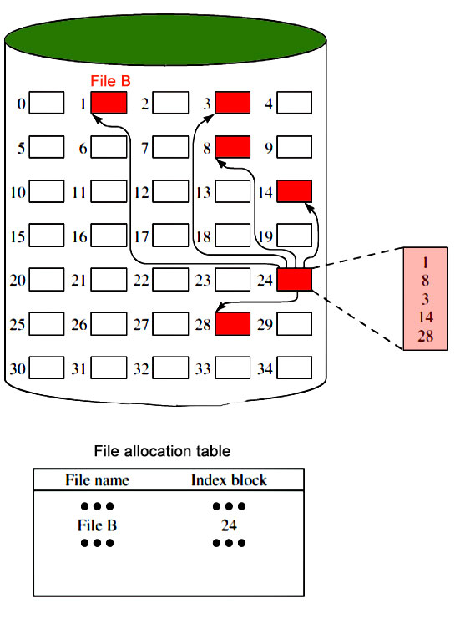
Indexed Allocation
It addresses many of the problems of contiguous and chained allocation. In this case, the file allocation table contains a separate one-level index for each file: The index has one entry for each block allocated to the file. Allocation may be on the basis of fixed-size blocks or variable-sized blocks. Allocation by blocks eliminates external fragmentation, whereas allocation by variable-size blocks improves locality. This allocation technique supports both sequential and direct access to the file and thus is the most popular form of file allocation.

Slide 21
Advantages of Index Allocation
The advantages of index allocation are:
The index allocation method solves the problem of external fragmentation.
Index allocation provides direct access.
Disadvantages of Index Allocation
The disadvantages of index allocation are:
In index allocation, pointer overhead is more.
We can lose the entire file if an index block is not correct.
It is totally a wastage to create an index for a small file.

Slide 22
A single index block cannot hold all the pointer for files with large sizes.
To resolve this problem, there are various mechanism which we can use:
Linked Scheme: - In the linked scheme, to hold the pointer, two or more than two index blocks are linked together. Each block contains the address of the next index block or a pointer.
Multilevel Index: - In the multilevel index, to point the second-level index block, we use a first-level index block that in turn points to the blocks of the disk, occupied by the file. We can extend this up to 3 or more than 3 levels depending on the maximum size of the file.
Combined Scheme: - In a combined scheme, there is a special block which is called an information node (Inode). The inode comprises of all the information related to the file like authority, name, size, etc. To store the disk block addresses that contain the actual file, the remaining space of inode is used. In inode, the starting pointer is used to point the direct blocks. This means the pointer comprises of the addresses of the disk blocks, which consist of the file data. To indicate the indirect blocks, the next few pointers are used. The indirect blocks are of three types, which are single indirect, double indirect, and triple indirect.

Slide 23
Inode
In the UNIX operating system, every file is indexed with the help of Inode. An Inode is a block that is created at the time when the file system is designed.
There are various types of information included in Inode:
Attributes of the file, such as timestamp, permissions, details, ownership, etc.
The total number of direct blocks that comprise of the pointer to the starting blocks.
In Inode, there is a single indirect pointer. It is used to point an index block. If using direct blocks, entire file cannot be indexed, then, in that case, we use a single indirect pointer.
Inode also contains a double indirect pointer. This pointer is used to point a disk block.
In Inode there is another pointer, which is a triple index pointer. This pointer is also used to point a disk block.

Slide 24
Directory Structure
What is a Directory
A Directory is the collection of the correlated files on the disk. In simple words, a directory is like a container which contains file and folder. In a directory, we can store the complete file attributes or some attributes of the file. A directory can be comprised of various files. With the help of the directory, we can maintain the information related to the files.

Slide 25
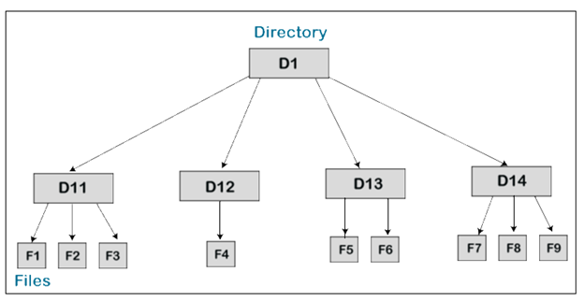
To take the advantages of various file systems on the different operating systems, we can divide the hard disk into multiple partitions, which are of different sizes. Partitions are known as minidisks or volumes.
There should be at least one directory that must be present in each partition. Through it, we can list all the files of the partition. In the directory for each file, there is a directory entry, which is maintained, and in that directory entry, all the information related to the file is stored.

Slide 26
There are various types of information which are stored in a directory:
Name: - Name is the name of the directory, which is visible to the user.
Type: - Type of a directory means what type of directory is present such as single-level directory, two-level directory, tree-structured directory, and Acyclic graph directory.
Location: - Location is the location of the device where the header of a file is located.
Size: - Size means number of words/blocks/bytes in the file.
Position: - Position means the position of the next-read pointer and the next-write pointer.
Protection: - Protection means access control on the read/write/delete/execute.
Usage: - Usage means the time of creation, modification, and access, etc.
Mounting: - Mounting means if the root of a file system is grafted into the existing tree of other file systems.

Slide 27
Operations on Directory
Creating: - In this operation, a directory is created. The name of the directory should be unique.
Deleting: - If there is a file that we don’t need, then we can delete that file from the directory. We can also remove the whole directory if the directory is not required. An empty directory can also be deleted. An empty directory is a directory that only consists of dot and dot-dot.
Searching: - Searching operation means, for a specific file or another directory, we can search a directory.
List a directory: - In this operation, we can retrieve all the files list in the directory. And we can also retrieve the content of the directory entry for every file present in the list.
If in the directory, we want to read the list of all files, then first, it should be opened, and afterwards we read the directory, it is a must to close the directory so that the internal tablespace can be free up.

Slide 28
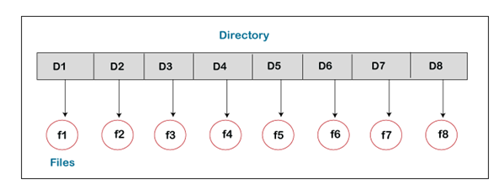
Types of Directory Structure
There are various types of directory structure:
Single-Level Directory: - Single-Level Directory is the easiest directory structure. There is only one directory in a single-level directory, and that directory is called a root directory. In a single-level directory, all the files are present in one directory that makes it easy to understand. In this, under the root directory, the user cannot create the subdirectories.

Slide 29
Advantages of Single-Level Directory
The advantages of the single-level directory are:
The implementation of a single-level directory is so easy.
In a single-level directory, if all the files have a small size, then due to this, the searching of the files will be easy.
In a single-Level directory, the operations such as searching, creation, deletion, and updating can be performed.
Disadvantages of Single-Level Directory
The disadvantages of Single-Level Directory are:
If the size of the directory is large in Single-Level Directory, then the searching will be tough.
In a single-level directory, we cannot group the similar type of files.
Another disadvantage of a single-level directory is that there is a possibility of collision because the two files cannot have the same name.
The task of choosing the unique file name is a little bit complex.
Two-Level Directory

Slide 30
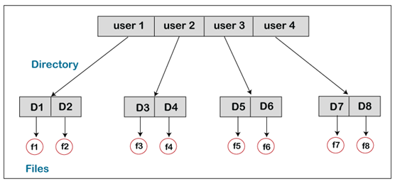
Two-Level Directory is another type of directory structure. In this, it is possible to create an individual directory for each of the users. There is one master node in the two-level directory that include an individual directory for every user. At the second level of the directory, there is a different directory present for each of the users. Without permission, no user can enter into the other user’s directory.

Slide 31
Characteristics of Two-Level Directory
The characteristics of the two-level directory are:
In a two-level directory, there may be same file name of different users.
There is a pathname of each file such as /User-name/directory-name/
In a two-level directory, we cannot group the files which are having the same name into a single directory for a specific user.
In a two-level directory, searching is more effective because there is only one user’s list, which is required to be traversed.
Advantages of Two-Level Directory
The advantages of the two-level directory are:
In the two-level directory, various users have the same file name and also directory name.
Because of using the user-grouping and pathname, searching of files are quite easy.
Disadvantages of Two-Level Directory
The disadvantages of the two-level directory are:
In a two-level directory, one user cannot share the file with another user.
Another disadvantage with the two-level directory is it is not scalable.
Tree-Structured Directory

Slide 32
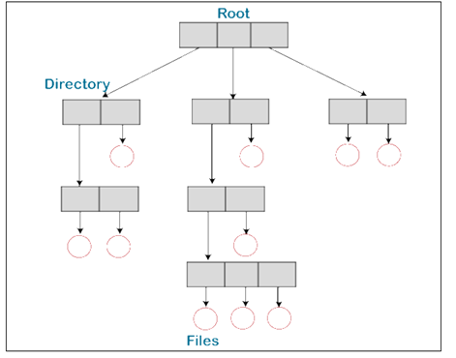
A Tree-structured directory is another type of directory structure in which the directory entry may be a sub-directory or a file. The tree-structured directory reduces the limitations of the two-level directory. We can group the same type of files into one directory.
In a tree-structured directory, there is an own directory of each user, and any user is not allowed to enter into the directory of another user. Although the user can read the data of root, the user cannot modify or write it. The system administrator only has full access to the root directory. In this, searching is quite effective and we use the current working concept. We can access the file by using two kinds of paths, either absolute or relative.

Slide 33
Advantages of tree-structured directory
The advantages of the tree-structured directory are:
The tree-structured directory is very scalable.
In the tree-structures directory, the chances of collision are less.
In the tree-structure directory, the searching is quite easy because, in this, we can use both types of paths, which are the absolute path and relative path.
Disadvantages of Tree-Structure Directory
The disadvantages of tree-structure directory are:
In the tree-structure directory, the files cannot be shared.
Tree-structure directory is not efficient because, in this, if we want to access a file, then it may go under multiple directories.
Another disadvantage of the tree-structure directory is that each file does not fit into the hierarchal model. We have to save the files into various directories.

